Slide 1
CHITLIN CIRCUIT
By (Write your Name Here)

Slide 2
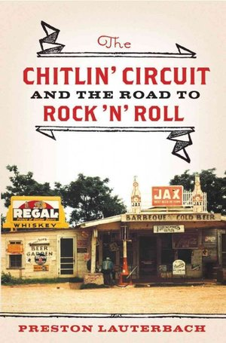
The Chitlin’ Circuit Term
This is one symbolic of the nature and the lifestyles that were prescribed to the black people in the times of extreme racial discrimination towards the end of 19th century in the United States.

Slide 3
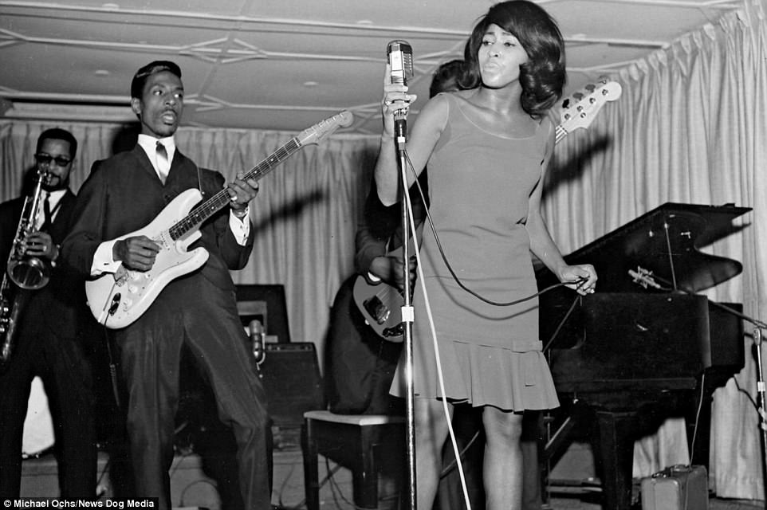
Causation for Chitlin’ Circuit
It was literally a movement for black emancipation in terms of offering entertainment gigs, joints, bookings and accommodation of stars that took part in the presentation of the works of literature. It created employment to blacks a t a time no jobs would come through for the blacks.

Slide 4
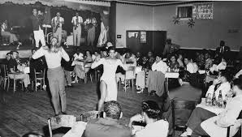
Historical Context of Chitlin Circuit
The inception of this movement came a time in the political arena that dictated division of all aspects of life based on one simple assertion; race.

Slide 5
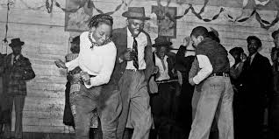
Organizational Context of the movement
The name Chitlin’ Circuit is drawn from the artistic performances that encompassed acceptance for Black-American comedians, musicians, disco jokers among other poetic artists. The organizers came up with venues such theatres, bars and clubs for performances e.g Apollo and Uptown.

Slide 6
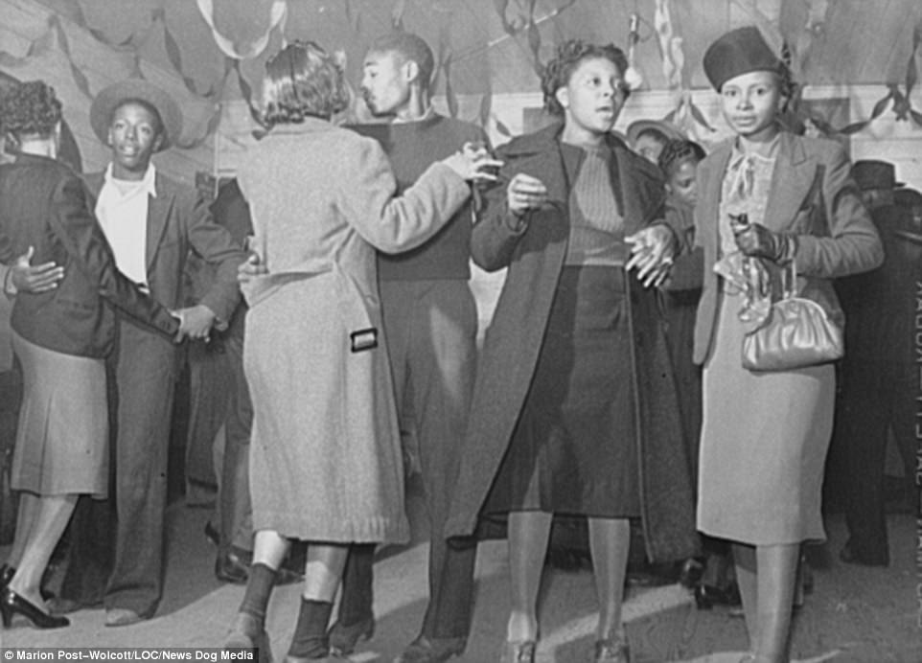
Contemporariness of Chitlin Circuit
Plays such admirable role in bridging the gap provides a resource base for the current theatre arts that has come with the changing times and technological advancements.

Slide 7
Conclusion
The underlying contributions of this movement are stored in the roles the women played in the movement, what it stood for( hiring of blacks) in the entertainment joints and eventual motivation to participating in the civil emancipation of black’s equal treatment.

